Slide 1
Tesla, Inc. Stock Price Prediction
University of San Diego - ADS 505
Ghassan Seba
Principal Component Analysis, Regression Tree model, Linear Regression Model
John Vincent Deniega
Data acquisition, data cleaning, standardization, EDA visuals, Neural Net Classifier, GitHub
Amy Ou
Random Forest model, model evaluation
Notes:
Executive Summary (voice-over on this slide after technical portion):
Problem Statement (voice-over): According to Forbes (2023) and US News (2023), our competitors in JP Morgan to Vanguard Group leverage artificial intelligence to augment their investment strategies. In order to keep pace and potentially overmatch our competitors, we must also deploy artificial intelligence applications and data science mining practices to our investment activities. In this test case, Tesla, Inc. stock price and other market data are used as a proof-of-concept to both understand and predict price action ahead of our competitors. This includes data sources from the NASDAQ stock exchange, the Standard and Poor’s 500 index, and US Federal Reserve interest rate decisions.
-Exponential growth of data = exponential opportunities to discover patterns using data science models
Period of Data: March 11, 2022 to September 13, 2023 (380 trading days)

Slide 2
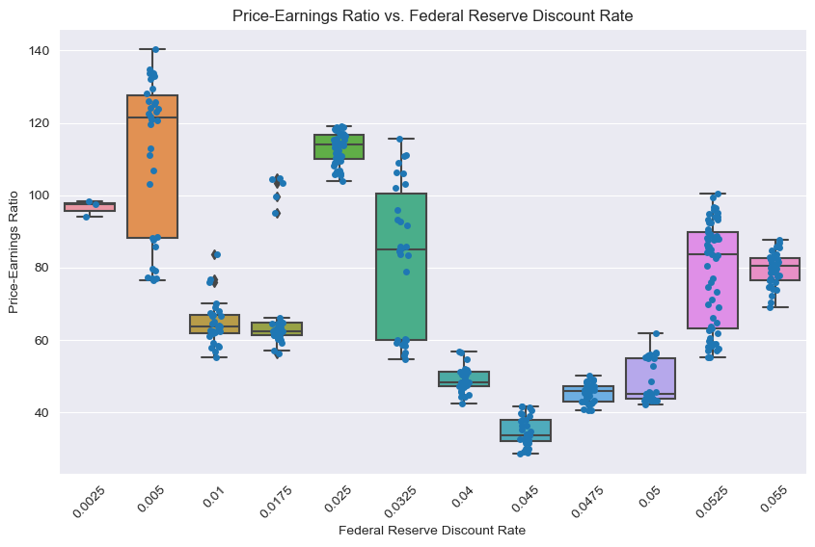
Actionable Insight #1
Business Recommendations #1
Figure 1 - Price-Earnings Ratio vs Federal Reserve Discount Rate
TSLA's Price-Earnings (PE) ratio exhibits large differences in both central tendencies and variation across different US Federal Reserve interest discount rates, suggesting that TSLA stock is highly sensitive to monetary policy changes.
Upon lead up to the US Federal Reserve Federal Open Market Committee’s interest rate decision, position portfolio for increased volatility.
Anticipate buying opportunity on overselling.
Notes:
Supporting Evidence: Throughout the range of interest discount rates, the median PE ratio went as low as 33.61 at 4.5 percent to as high as 121.38 at 0.5 percent. The PE standard deviation during the period of increase beginning March 2022 through September 2023 ranged from a low of 2.59 at 4.75 percent to 21.41 at 0.5 percent, demonstrating significant changes in PE variation and supporting the thesis of TSLA's tendency for changes in volatility. Because the movement between the high and low is not monotonic, it cannot yet concluded that the two are covariant, but the data support that an interest change occurring in itself with all else being equal causes the market to reset and reprice TSLA shares.

Slide 3
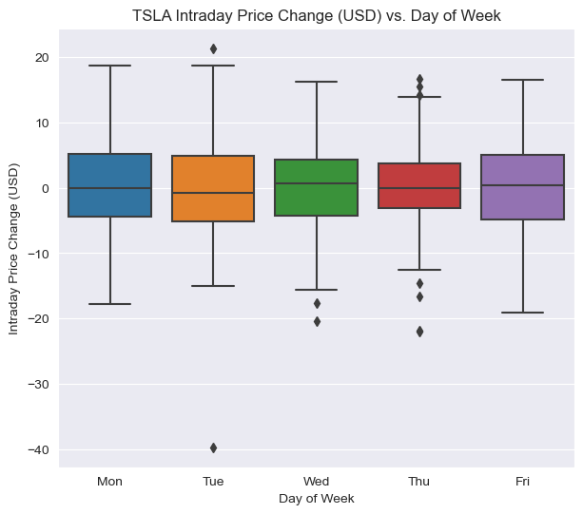
Actionable Insight #2
Business Recommendations #2
Figure 2 - TSLA Intraday Price Change (USD) vs. Day of Week
Beginning of the week exhibits the greatest volatility (maximum interquartile range).
Wednesdays exhibit a tendency for positive price action (positive median).
Thursdays exhibit the lowest volatility (minimum interquartile range).
Rely on high confidence BUY or SELL calls only as beginning week prices tend to experience higher volatility.
Ideally, buy shares or CALL options before Wednesday’s market open.
Deploy strategies favorable to low volatility on Thursday such as Iron Condor options or HOLD.

Slide 4
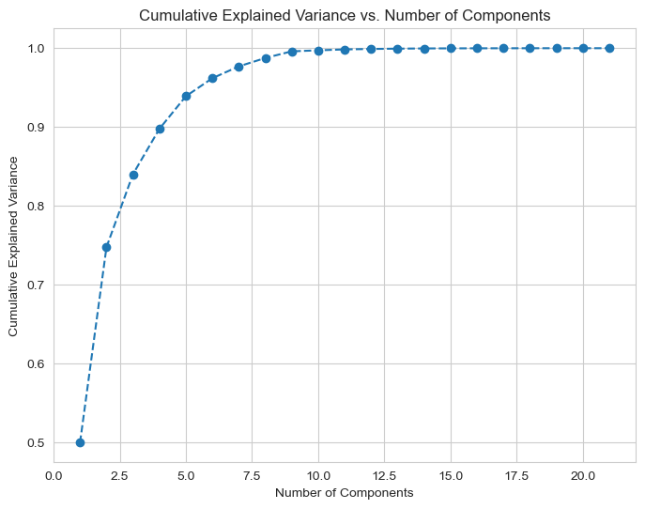
Actionable Insight #3: Principal Component Analysis (PCA)
Business Recommendations #3
Figure 3 - Balancing Data Complexity with Key Insights
Focusing on Important Information
More Accurate and Robust Predictions
More Efficient Analytics
Deploy stock price prediction model to predict Tesla's stock price based on 6 key business and market factors.
Utilize insights from the model to help make informed investment decisions.

Slide 5
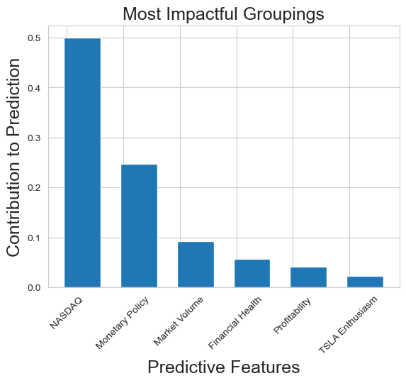
Actionable Insight #4: Principal Component Analysis (PCA)
Business Recommendations #4
Figure 4 - Optimizing Key Business Drivers: Impactful Groupings
Certain factors behave in groups and can reveal relationships.
Align strategies with these identified groupings
Contextualize findings with business expertise to determine causality

Slide 6
Next Steps for Future Work
References
Cooper, M. (2023, April 20). Rise of the AI investment bankers. Forbes. https://www.forbes.com/sites
/forbesfinancecouncil/2023/04/20/rise-of-the-ai-investment-bankers/?sh=4196797648f7
O’Connell, B. (2023, July 6). 7 Top investment firms using AI for asset management. US News.
https://money.usnews.com/investing/articles/7-top-investment-firms-using-ai-for-asset-management
Deploy predictive models to market conditions to test risk-reward of model strategies
Discover other market trends that may exist throughout the week
Understand the components that could influence other stock price
Follow up on TSLA text-based news to predict potential increase or decrease in stock price
Demonstrate the model’s versatility by utilizing it on an expanded portfolio

